Slide 1
IBM HR Analytics SQL Project
Business Case Study - Employee Attrition Analysis Using SQL
Dataset
IBM HR Analytics Employee Attrition Dataset (Kaggle)
Skills Used:
• SQL
• CASE WHEN
• GROUP BY
• Aggregate Functions
• Subqueries
• Window Functions (RANK)
• Business Analysis
Prepared By:
V.Lalitha Sahana
Aspiring Data Analyst

Slide 2
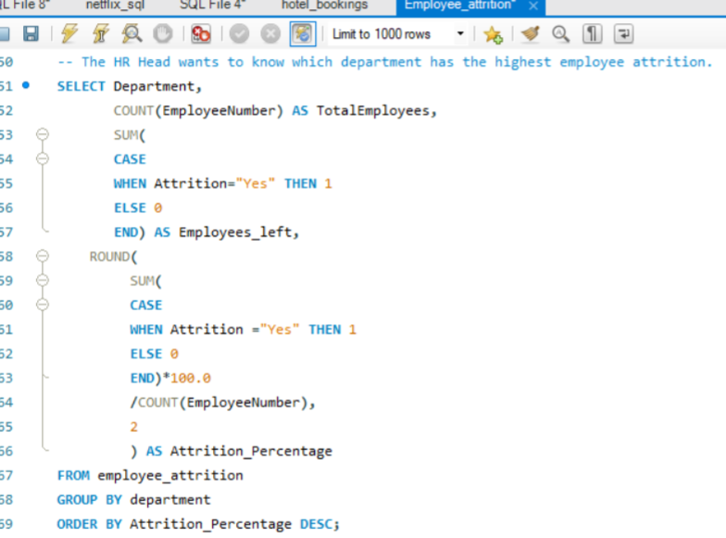
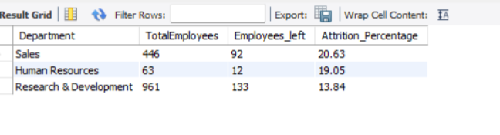
1. Department-wise Employee Attrition Analysis
Business Question:
Which department has the highest employee attrition percentage?
SQL Query: Query Output:
Business Insight:
Sales has the highest employee attrition rate (20.63%).
Human Resources follows with 19.05%.
Research & Development has the lowest attrition rate (13.84%).

Slide 3
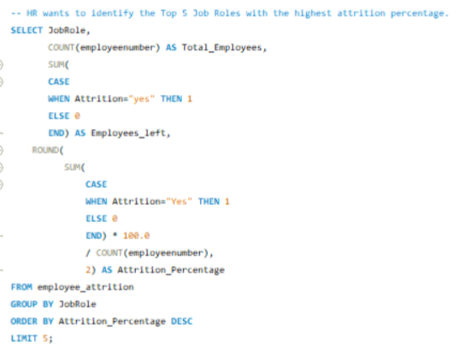
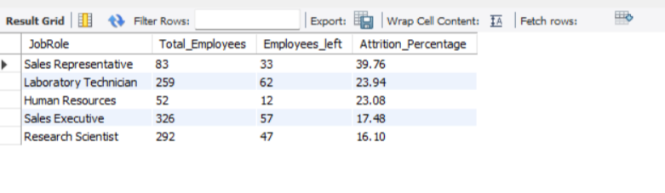
2. Job Role-wise Employee Attrition Analysis
Top 5 job roles with highest employee attrition percentage?
SQL QUERY: QUERY OUTPUT:
Business Insight:
Sales Representative has the highest attrition rate (39.76%).
Laboratory Technician follows with 23.94%.
Human Resources records 23.08% attrition.
These roles may require better retention strategies and employee engagement initiatives.

Slide 4
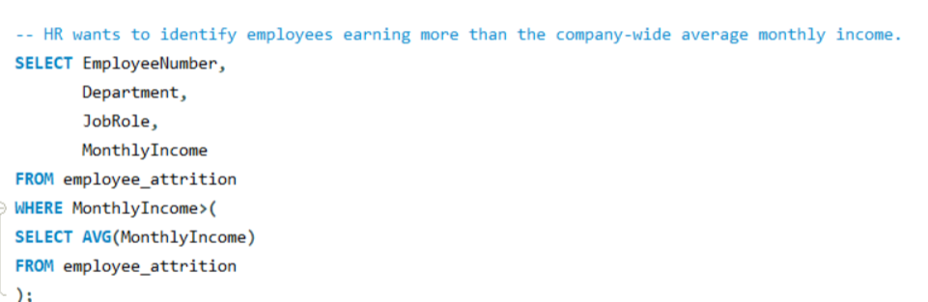
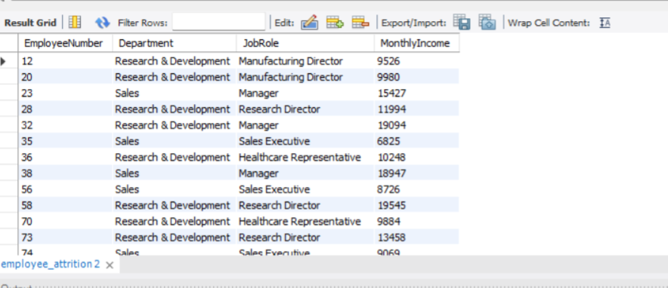
Employees Above Average Salary
Which employees earn above the company's average salary?
SQL QUERY:
QUERY OUTPUT:
Business Insight:
Above-average salaries are concentrated in senior and specialized roles, supporting HR in compensation benchmarking and workforce planning.

Slide 5
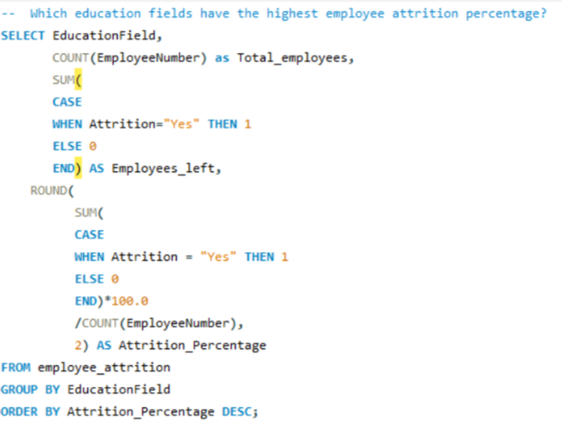
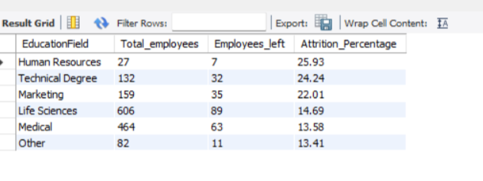
Education Field-wise Employee Attrition Analysis
Which education fields have the highest employee attrition percentage?
SQL QUERY: QUERY OUTPUT:
Business Insight: Employees from Human Resources (25.93%) and Technical Degree (24.24%) education fields have the highest attrition rates, highlighting the need for targeted retention strategies..

Slide 6
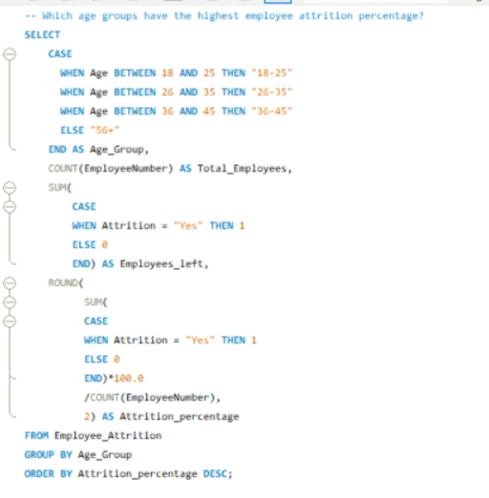
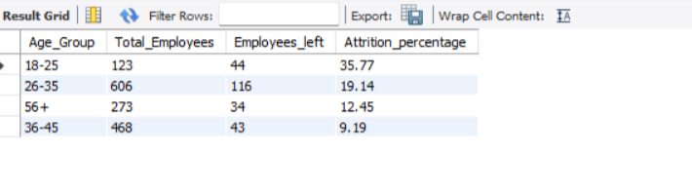
Age Group-wise Employee Attrition Analysis
How does employee attrition vary across different age groups?
SQL QUERY: QUERY OUTPUT:
Business Insight:
Employees aged 18–25 (35.77%) have the highest attrition rate, indicating that younger employees are more likely to leave the organization. This highlights the need for targeted retention Strategies for early career employees.

Slide 7
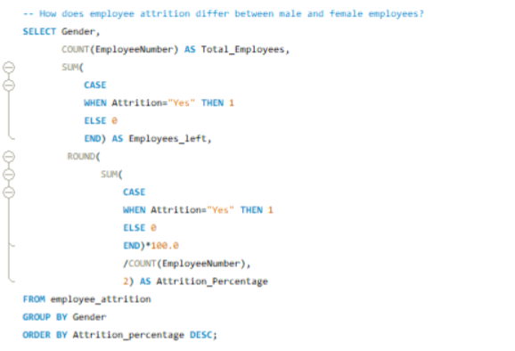
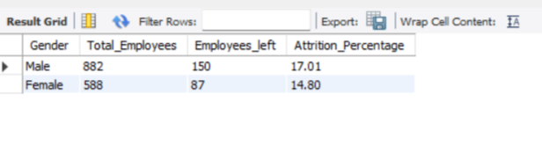
Gender-wise Employee Attrition Analysis
How does employee attrition differ between male and female employees?
SQL QUERY : QUERY OUTPUT:
Business Insight: Male employees (17.01%) have a higher attrition rate than female employees (14.80%), indicating a need for targeted retention strategies.

Slide 8
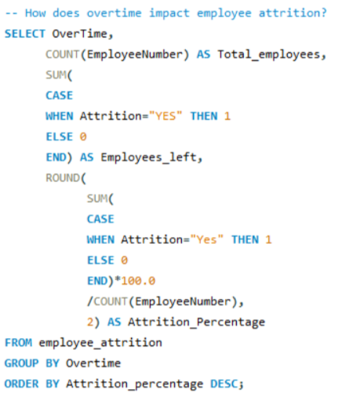
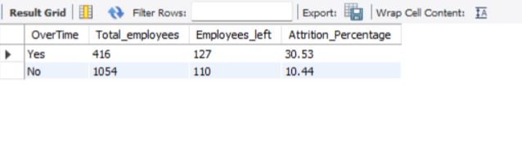
Overtime vs Employee Attrition Analysis
How does overtime impact employee attrition?
SQL QUERY: QUERY OUTPUT:
Business Insight: Employees working overtime (30.53%) have a significantly higher attrition rate than those not working overtime (10.44%), indicating that excessive workload may be a key driver of employee turnover.

Slide 9
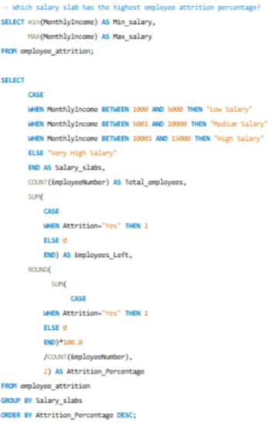
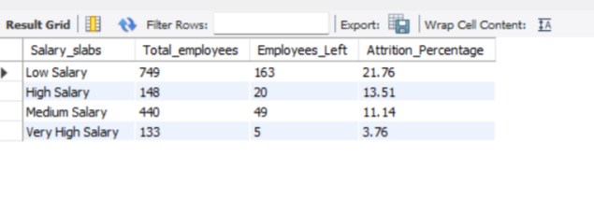
Salary Slab-wise Employee Attrition Analysis
Which salary slab has the highest employee attrition percentage?
SQL QUERY: QUERY OUTPUT:
Business Insight: Employees in the Low Salary slab (21.76%) have the highest attrition rate, while the Very High Salary slab (3.76%) has the lowest, suggesting that competitive compensation plays a significant role in improving employee retention.

Slide 10
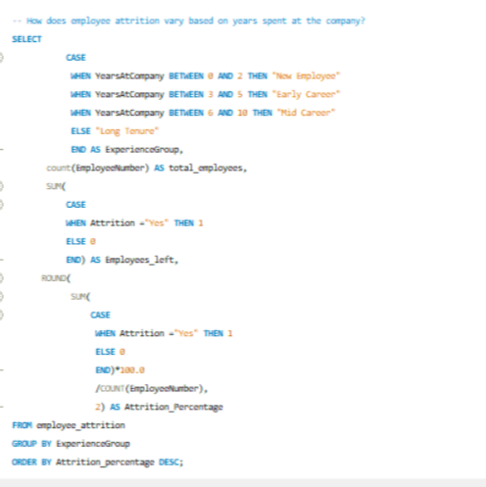
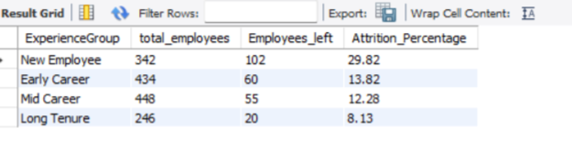
Years at Company vs Employee Attrition Analysis
How does employee attrition vary based on years spent at the company?
SQL QUERY: QUERY OUTPUT:
Business Insight: New Employees (29.82%) have the highest attrition rate, while Long Tenure employees (8.13%) have the lowest, indicating that improving onboarding and early employee engagement can significantly reduce turnover.

Slide 11
Overall Project Conclusion & Recommendations
Key Findings:
Employee attrition is influenced by age, salary, overtime, experience, education field, and gender.
New employees, low-salary employees, and those working overtime showed the highest attrition rates.
Employees aged 18–25 experienced the highest turnover, while long-tenured employees had the lowest.
Employees from Human Resources and Technical Degree education fields recorded the highest attrition rates.
Business Recommendations:
Strengthen onboarding and mentoring programs for new employees.
Review compensation structures and career growth opportunities for lower-salary employees.
Reduce excessive overtime and improve work-life balance.
Develop targeted retention initiatives for high-risk employee groups.
Project Outcome
This SQL analysis transformed raw HR data into actionable business insights, enabling HR teams to identify attrition patterns and support data-driven workforce decisions.

